Slide 1
The Butterfly Effect of the Lorenz System
Formerly “The Butterfly Effect of the Lorenz Equation”

Slide 2
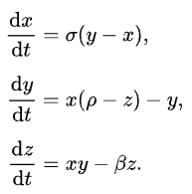

General idea of Lorenz System
What is it?
Set of 3 ODEs by Edward Lorenz
“The model describes how three key properties of this system change over time:
x is proportional to the intensity of the convection (the rate of fluid flow).
y is proportional to the temperature difference between the rising and falling air currents.
z is proportional to the distortion of the vertical temperature profile from a linear one.
“ from “https://en.wikipedia.org/wiki/Lorenz_system”
Chaos Theory

Slide 3
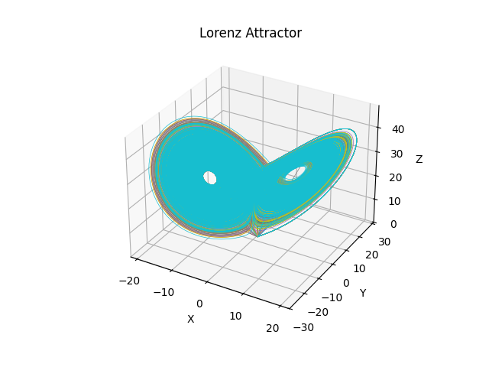
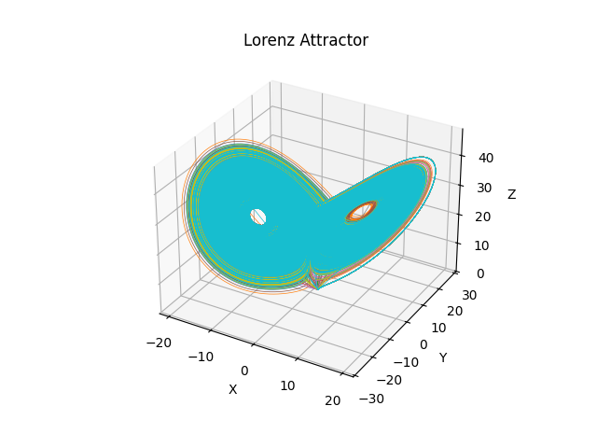
Applications of Lorenz System
Primarily used for modeling chaotic systems with unpredictable behavior (ie atmospheric science, fluid dynamics, etc.)
←
0.0001
Chaos
→
0.1
Notes:
Small perturbation
Trajectories start almost identical
Then slowly diverge
Looks like a tight bundle
Larger perturbation
Trajectories start more spread out
They diverge faster
Looks like distinct colored strands

Slide 4
Numerical method used
Initially: Riemann Sum
Transitioned to Euler then to RK4
What is and Why RK4?
RK4 is for Runge–Kutta 4th order method. It is a numerical technique used to approximate solutions to differential equations. At each time step, you estimate the slope multiple times and combine them to produce a more accurate result.
Also,
When researching further, google told me that RK4 was better.
Researching further to verify information for report.
rasimi, krutan. “Dynamics of Fractional-Order Lorenz System Applying Different Numerical Methods.” International Journal of Applied Mathematics, Academic Publications. International Journal of Applied Mathematics Volume 35 No. 2 2022, 297-306
Notes:
https://www.academia.edu/120511679/Dynamics_of_Fractional_Order_Lorenz_System_Applying_Different_Numerical_Methods

Slide 5
Demo

Slide 6
Building and Running
Build
Mac (arm)
clang lorenz_openmp.c -o lorenz -I/opt/homebrew/opt/libomp/include \ -L/opt/homebrew/opt/libomp/lib -Xpreprocessor -fopenmp -lomp -lm
Linux (x86)
gcc -g -Wall -fopenmp lorenz_openmp.c -o lorenz -lm
Running
./lorenz
Python Plot
python plot_lorenz.py

Slide 7
Code Walkthrough

Slide 8
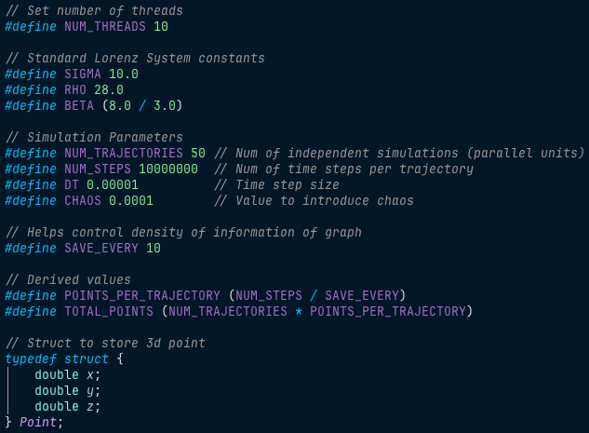
Modularity

Slide 9
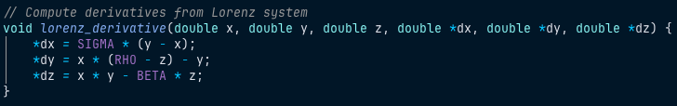
Lorenz System

Slide 10
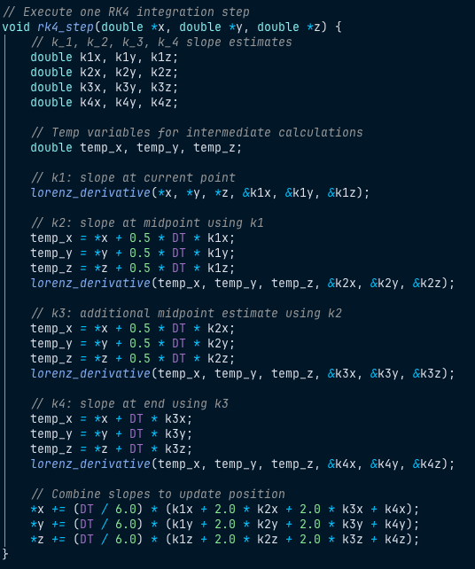
RK4
Slope estimations

Slide 11
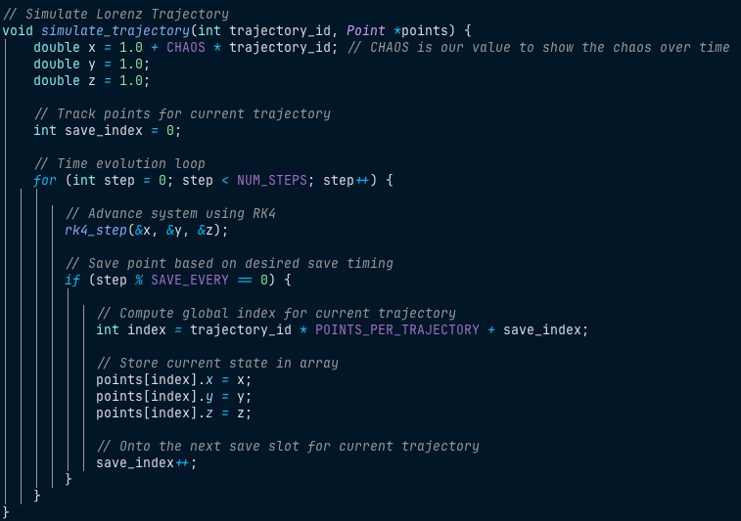
Trajectory

Slide 12
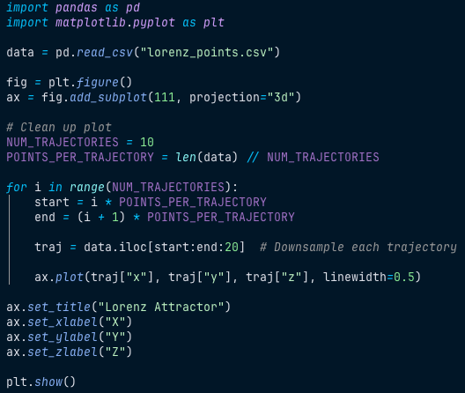
Plot
data: Hard coded file name
fig: use whole canvas
subplot: 1 row, 1 column, first plot
Cleaning up plot: reduce density of plot for clarity
Downsample: for clarity
Linewidth: for clarity

Slide 13
Parallel Zoomed In

Slide 14
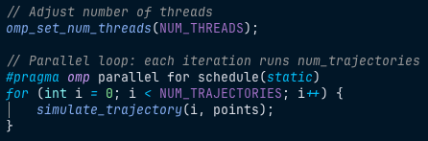
OpenMP
omp_set_num_threads to set threads from top of code
schedule(static) to split work beforehand
threads write without race conditions
https://learn.microsoft.com/en-us/cpp/parallel/openmp/d-using-the-schedule-clause?view=msvc-170

Slide 15
Speed Up

Slide 16
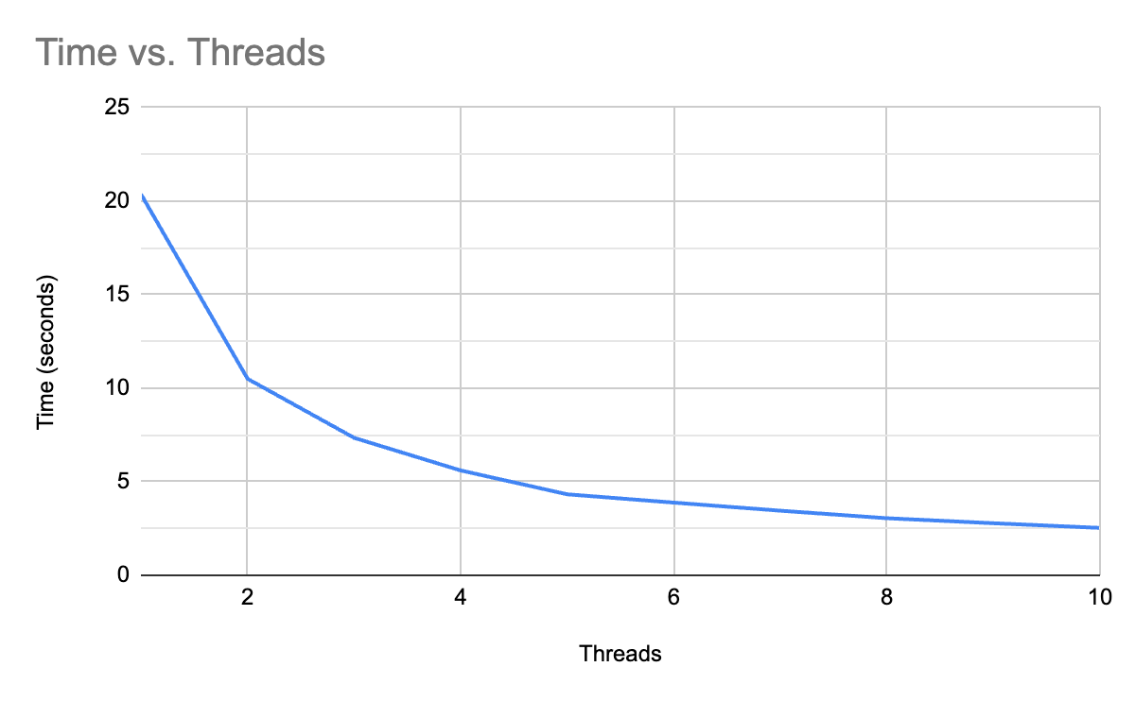
Proof for Business Majors, so we can get paid
Threads | Time (seconds)
1 | 20.360398
2 | 10.499632
3 | 7.344765
4 | 5.601659
5 | 4.32706
6 | 3.882279
7 | 3.450873
8 | 3.048965
9 | 2.780692
10 | 2.531211
8.04 times SPEEDUP!

Slide 17
Proof for Engineers, so we can get paid
Speedup = T_1 / T_10 = 20.360398 / 2.531211 ≈ 8.04x
Parallel % ≈ 97.3%
SU = 1 / ((1-P) + P / N)
8.04 = 1 / ((1 - P) + P / 10)
(1 - P) + P / 10 = 1 / 8.04
(1 - P) + P / 10 ≈ 0.1244
1 - P + 0.1P = 0.1244
1 - 0.9P = 0.1244
…
P ≈ 0.973
Sequential % ≈ 2.7%
1 - P = 1 - 0.973 ≈ 0.027
Speed up (Amdahl’s Law) achieved:
SU = 1 / ((1 - 0.973) + 0.973 / 10)
= 1 / (0.027 + 0.0973)
= 1 / 0.1243
≈ 8.04x

Slide 18
Reflection

Slide 19
Finding a way to expand graph so that I can implement more data without reducing data logging for plot clarity.
Modularity can be extended to terminal arguments. (ie filename, threads, etc)
System encountered SWAP, so times definitely could be better as I increased threads. Is this a HPC situation? CUDA? schedule(dynamic)?
Paper covered similar accuracies between Euler and RK4. Are there better/similar accuracy numerical methodologies with even better speeds?

